Slide 1
Literary Criticism (BA-TY)
Dr. Nirmala S. Padmavat
Director, IQAC
Nutan Mahavidyalaya, Selu

Slide 2
Longinus
Introduction :Longinus is the first Romantic critic. He is the pioneer in the field of literary appreciations. “On the Sublime” is a unique treatise on style. It is written in Greek. Its declared subject if Rhetoric but its central argument is what constitutes sublimity in literature.
Before Longinus the function of literature was summed up in the three word formulas that are to instruct to delight and to persuade. Longinus found these three word formula essential wanted for language. He discovered that the masterpieces of Greek classical literature were great because of sublimity.
According to Longinus sublimity consists in a certain distinction and consummate excellence in expression.

Slide 3
Longinus
Longinus says that not instruction or delight or persuasion is the test of great literature but transport its capacity to move the reader to ecstasy - caused by irresistible magic of speech. If the reader is spell bound by what the writers say the work has the quality of sublime. According to Longinus is moving power of the literature attains to sublimity. He says that when the power of speech is sublime or truly lofty. It is not only pleases but excites. Moves, transports, elevate. It does not so at once but every time it is heard or read. Longinus says that those examples of sublimity which always please and please all are truly beautiful and sublime.

Slide 4
The Sources of Sublime
Longinus says that both nature and art contribute to sublimity in literature. He aptly puts it –
‘Art is perfect when it seems to be nature, and nature hits the mark when she contains art hidden within her’.
Longinus finds five principal sources of the sublime, the first two of which are largely the gifts of nature and the remaining three the gifts of art.

Slide 5
Five Principal Sources of the Sublime
Grandeur of thought
Capacity for strong emotions
Appropriate use of figures of speech
Nobility of diction
Dignity of composition
A happy synthesizes of all the preceding gifts. All these pre-suppose as a common foundation an indispensable preliminary gift the command of language.

Slide 6
Grandeur of Thought
Nobody can produce a sublime work unless his thoughts are sublime. For sublimity is the echo of greatness of soul. It is impossible for those whose whole lives are full of mean and servile ideas and habits to produce anything that is admirable and worthy of an immortal life.
It is only natural that great decent should fall from the lips of those whose thoughts have always been deep and full of majesty. Stately thoughts belong to the loftious mind. Mostly they are innate but they can also be acquired by a proper discipline. Longinus links sublimity of thought and he assigns a higher purpose to the resulting transport that caused by the noblest thoughts finding then natural expression in the noblest language.

Slide 7
Capacity for Strong Emotions
The second natural source of sublimity is the capacity for strong emotion. Longinus asserts that nothing contributes more to loftiness of tone in writing than genuine emotion. Longinus says’ “I would confidently affirm that nothing makes so muck for grandeur as true emotion in the right place, for inspires the words, as it were, with a wild gust of mad enthusiasm and fills them with divine frenzy.”
Like stately thoughts, stately emotions also belong to the loftiest souls. They equally lead to loftiness of utterance. But they have to be true emotions and in the right place.
If sublimity is considered the chariot, grandeur of thought and capacity for strong emotion are the two mighty wheels, without which the chariot of sublimity can’t move an inch.

Slide 8
Appropriate Use of Figures of Speech
The third source of attaining excellence of style is the use of figures of speech which he considers very important and so devotes nearly one third of his work to it. According to Longinus figures of speech should not be used mechanically, rather they must be routed in genuine emotion, figures should be used naturally because they satisfy basic demand of human nature - that for a pleasant surprise. He says that a figure is effective when it appears in disguise.
The chief figures that make for sublimity are the rhetorical question, asyndeton, hyperbaton and periphrasis. In brief, the use of figures must be psychological intimately connected with thought and diction and not merely mechanical.

Slide 9
Nobility of Diction
The fourth source of the sublime is diction which comprises (the proper choice of words and arrangement, the use of metaphors and ornamented language). Longinus says that when words are suitable and striking, they have a moving and seductive effect upon the reader and they lend grandeur, beauty and mellowness, dignity, force, power, and a sort of glittering charm to the style. Words breathe voice in death things. They are the very light of thought. According to Longinus imposing language is not suitable for every occasion. Among the ornament of speech Longinus considers metaphor and hyperbole.

Slide 10
Dignity of composition
The fifth source of the sublimity is the dignity of composition or the arrangement of words. It should be one that blends thought, emotion, figures, and words themselves – the preceding four elements of sublimity – into a harmonious whole. Such an arrangement has not only a natural power of persuasion and of giving pleasure but also the marvelous power of exalting the soul and swaying the heart of men. It makes the hearer or the reader share the emotions of the speaker. But if the elements of grandeur be separated from one another the sublimity is so uttered. A harmonious composition alone sometimes makes up for the deficiency of the other elements.

Slide 11
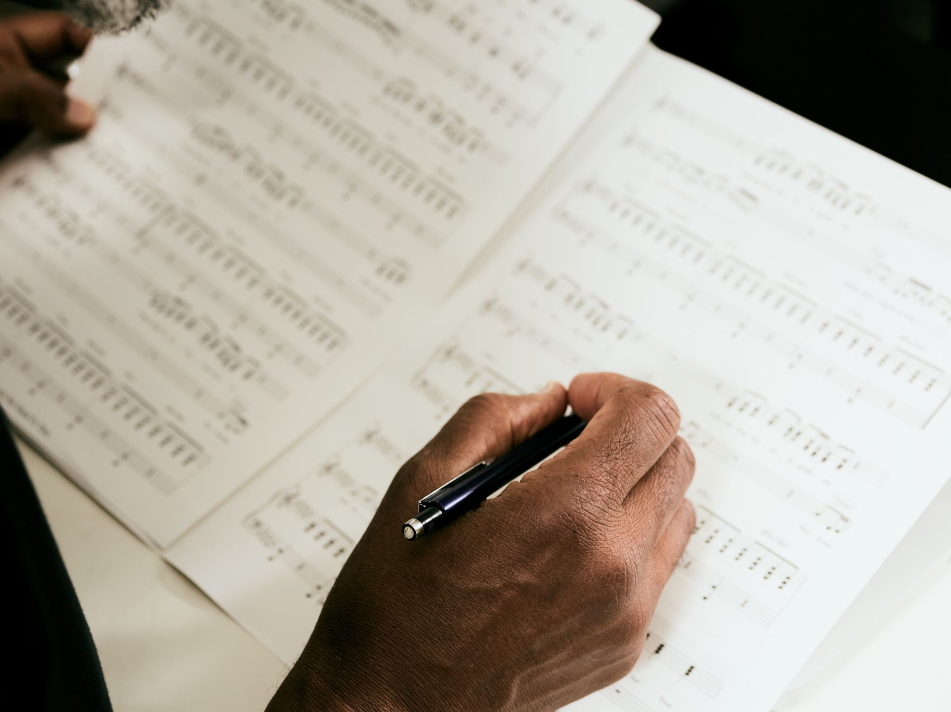
Conclusion
Longinus's work also emphasizes the importance of rhetorical techniques and figures of speech in achieving the sublime. He highlights the use of metaphors, amplification, and vivid descriptions as tools to create an emotional connection with the audience. Moreover, he argues that the sublime can be found in both prose and poetry, as it is a matter of the power of thought and expression rather than a specific literary form.

Slide 12
Thank yoU!

